Slide 1
Liberating Structures @XP Days
Amanda and Martin
info@access-innovation.de

Slide 4
A String For Anything!
Impromtu Networking Spiral Journal Troika Consulting

Slide 5
Impromptu Networking
1. When were you last curious about something new?
2. What did you do about it?
In each round, 2 minutes per person to answer the questions.

Slide 6
Spiral Journal
Q1 (upper left corner)
the comfortable perch (zone/space) where I am practicing is…
Q2 (upper right)
if I were to leave my perch, some new challenges that evoke fear and intrigue include…
Q3 (lower left)
good things about staying in my comfort zone include…
Q4 (lower right)
things people might say about me if I went beyond my comfort zone include…

Slide 7
Troika Consulting
Invite participants to reflect on the consulting question.
1 min explain your topic to your consultants
2 min consultants ask clarifying questions
Client turns around!
5 min consultants generate ideas, ideas, suggestions, coaching advice
2 min client turns around and shares what was most valuable about the experience

Slide 8
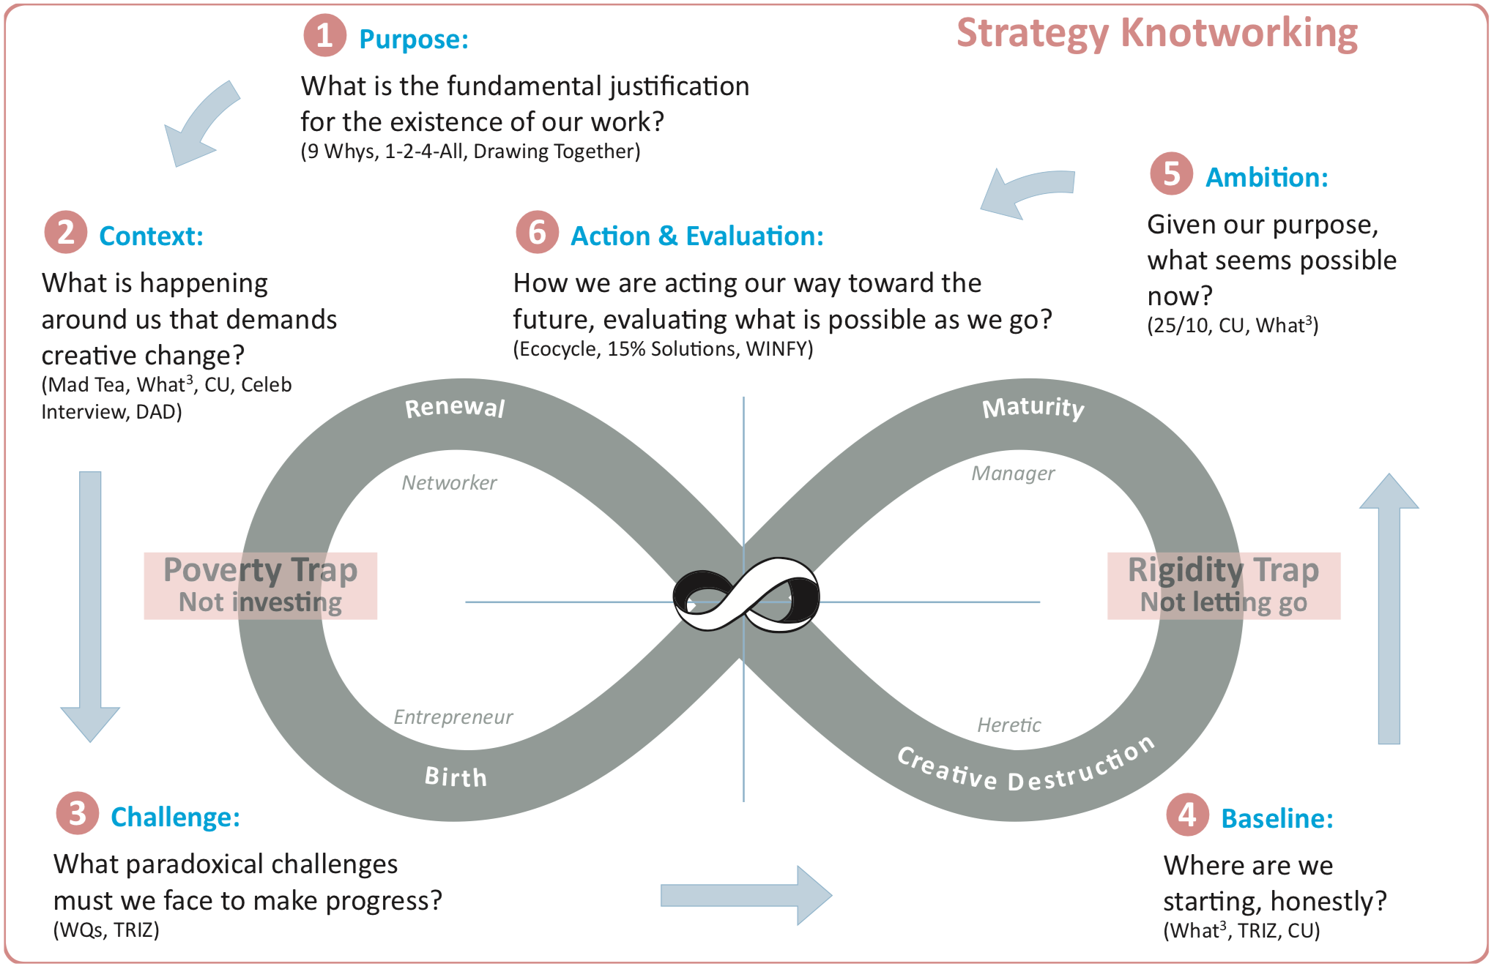

Slide 9
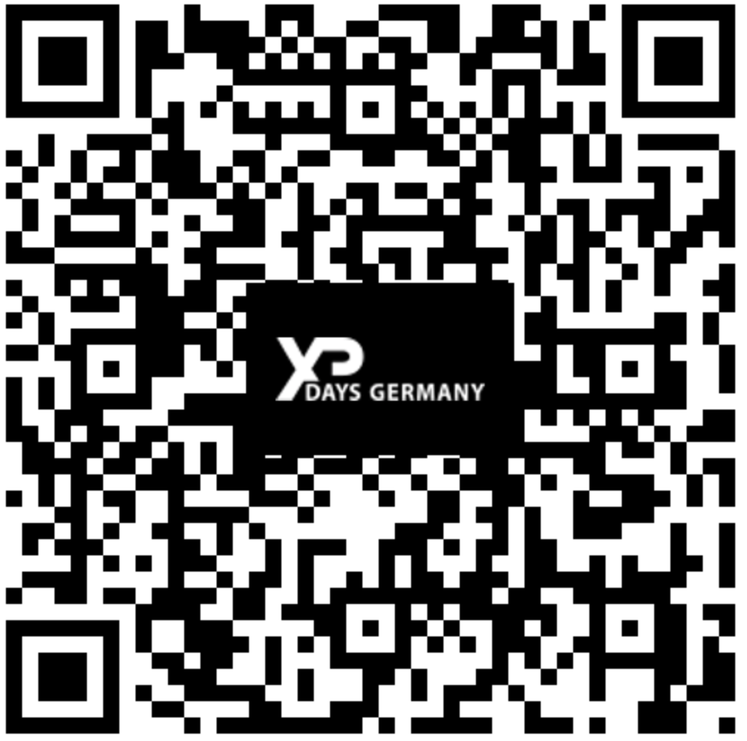
Your Feedback Amanda & Martin info@access-innovation.de

